Slide 1
Thinking DSLs for Massive Visualization
Emina Torlak,
Matthew Torok, Edward Lu, Rastislav Bodik
Leo Meyerovich
UC Berkeley | http://swivel.io
2013

Slide 2
VMs

Slide 3
type-level computation

Slide 4
social computing

Slide 5
program synthesis

Slide 6
program synthesis
is
awesome.

Slide 7
program synthesis
for
parallel patterns.

Slide 8
program synthesis
is
awesome.

Slide 9
Life Without Synthesis
sed “s/(\w).*\s+(\w+)/\2., \1./”
find
replace
\w . * \s + \n [] [^] - \d \D \S \W [\b] ^ $ \A \Z \z | ? ??
*? +? {n} {n,m} {n,m}? {n,} {n,}? \b \B \Q…\E \xFF \n \cA

Slide 10
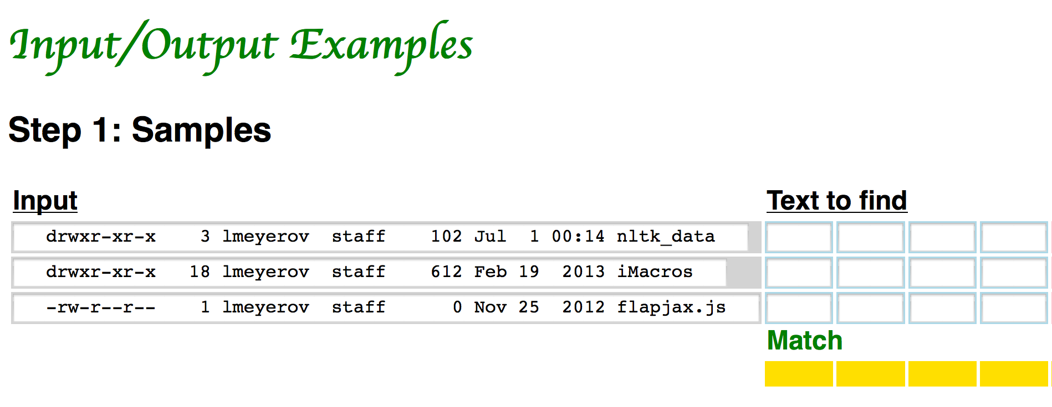

Slide 11
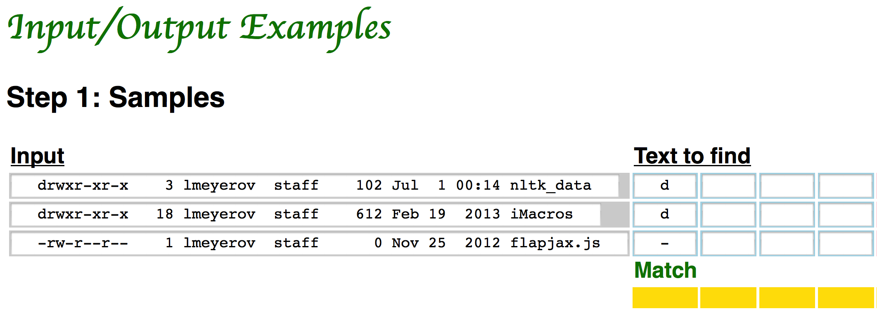

Slide 12
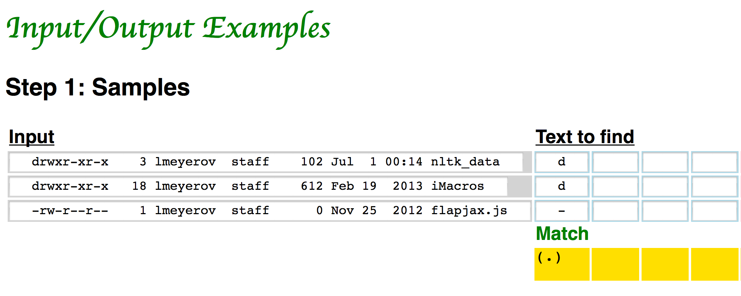
/./

Slide 13
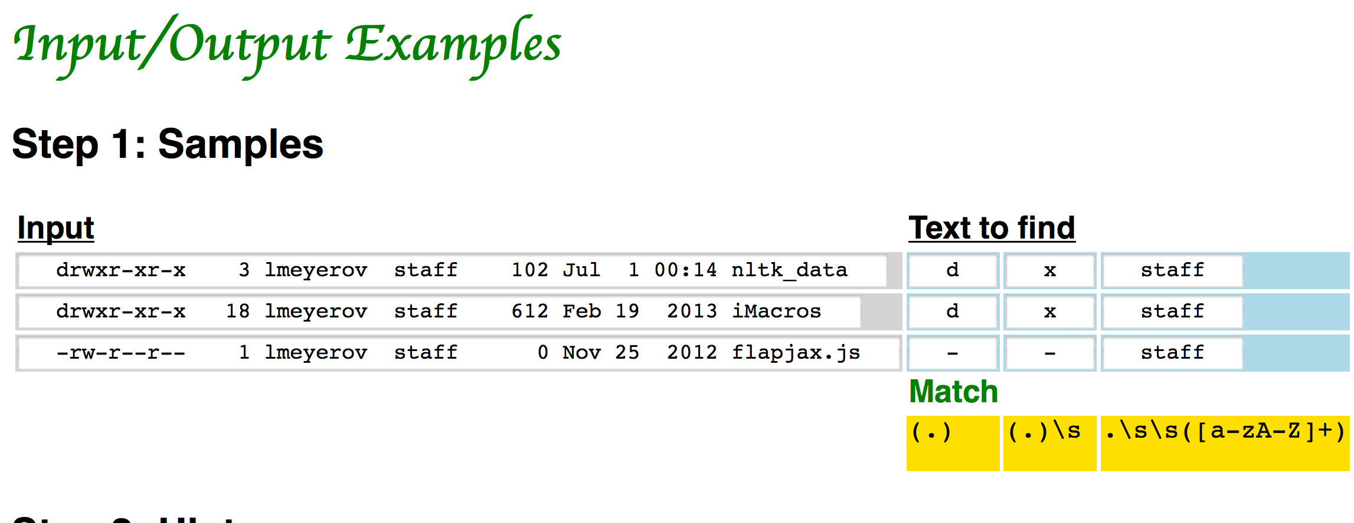
/./ .\s .\s\s[a-zA-Z]+

Slide 14
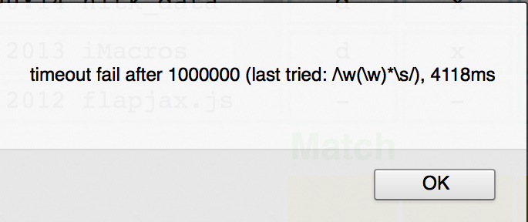
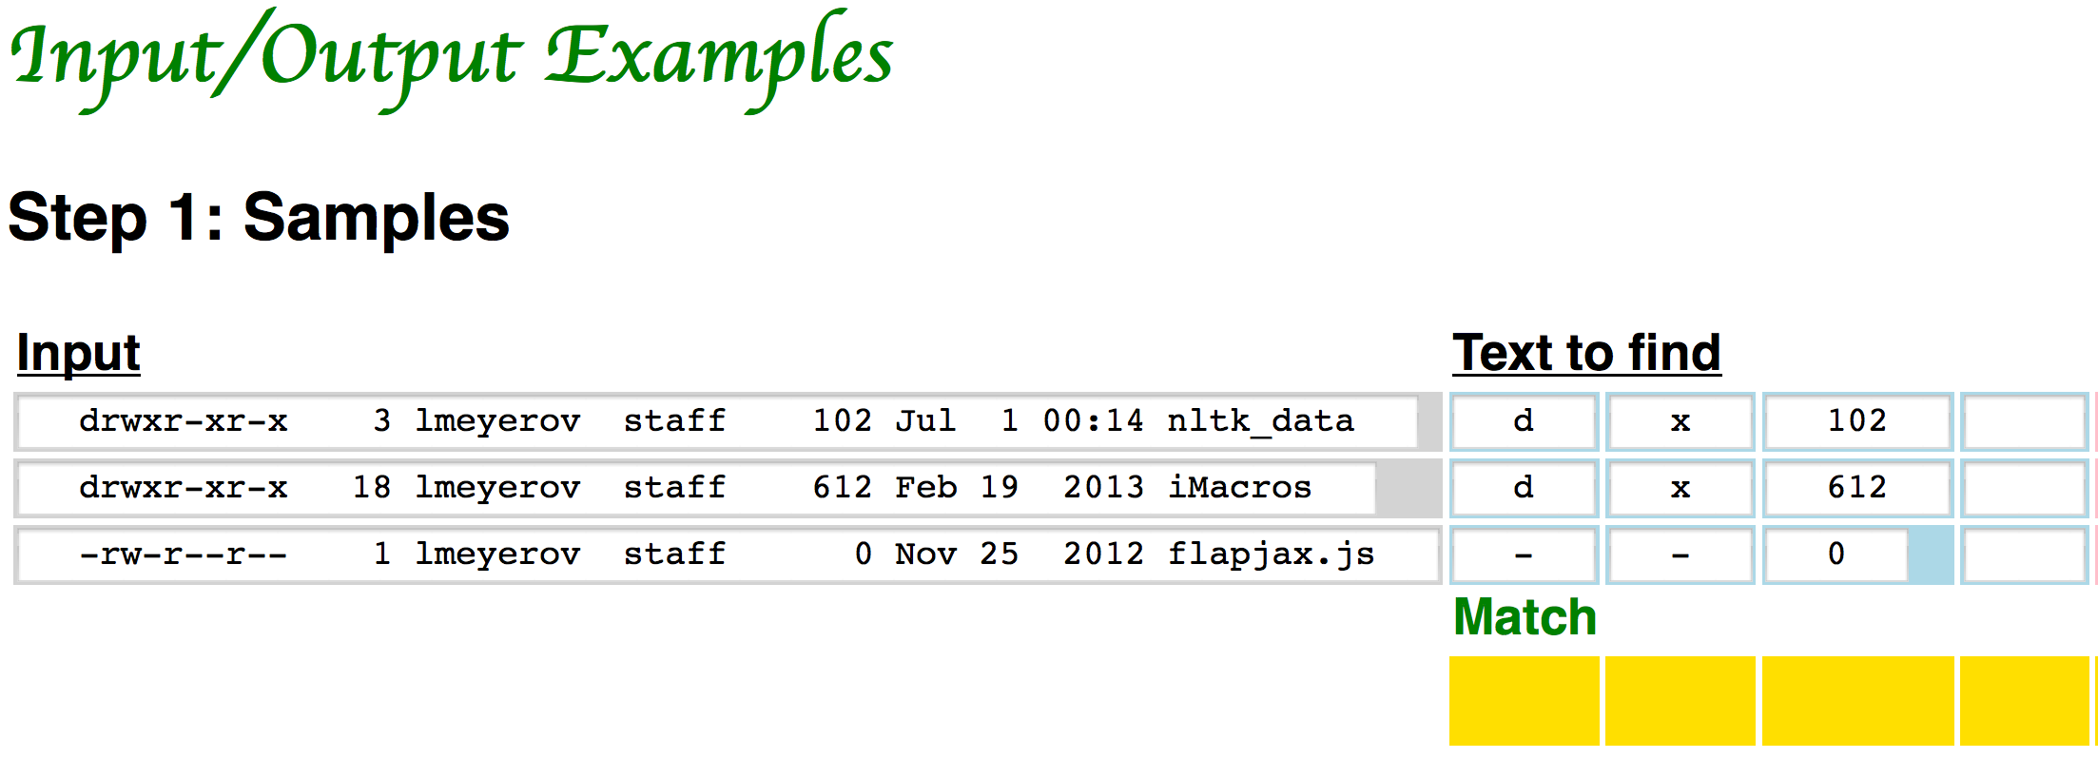
/./ .\s .\s\s[a-zA-Z]+

Slide 15
/./ .\s .\s\s[a-zA-Z]+
Hint: “it uses…”

Slide 16
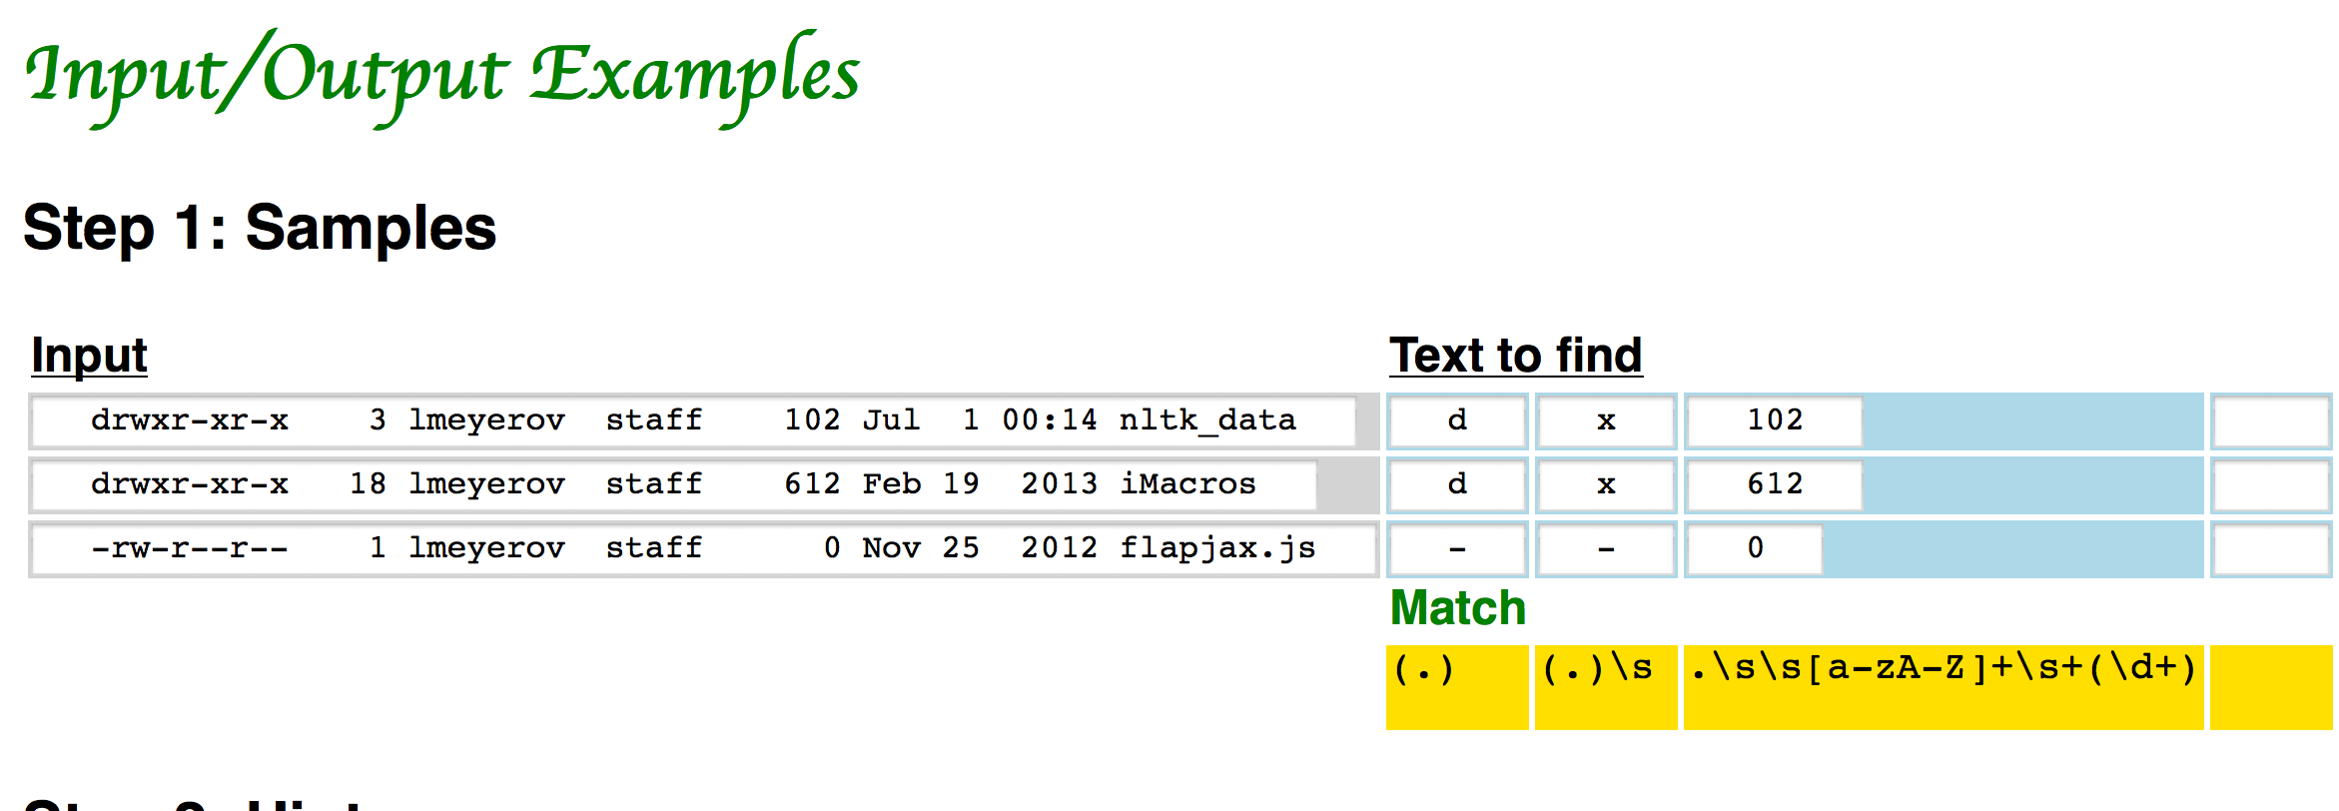
/./ .\s .\s\s[a-zA-Z]+
Hint: “it uses…”

Slide 17
A Really Stupid Synthesizer
Enumerate
1 .
2 \w
3 \d
4 *
5 \w*
6 \d*
7 .\w
8 \d
Check
✖
✖
✖
✖
✔
Standard Tricks
Prune bad programs
Prioritize hints
No numbers in examples, so prune ‘\d’ terms

Slide 18



An SMT Synthesizer in 2 Nights with Rosette
Rosette.rkt
Racket

Slide 19
An SMT Synthesizer in 2 Nights with Rosette
Regex Generator
Examples
(define (gen-regex k)
(if (= k 1)
(choose* “[a-zA-Z] “\d” “\s”)
(string-append
(gen-regex (- k 1))
(choose* “|” “”)
(gen-regex (- k 1)))))
(define rgx (gen-regex 5))
(solve rgx
(assert (equal?
“T”
(regexp-match rgx “Turing”))))
Create symbolic expression
Send to SMT solver
x :: symbolic → f(x) :: symbolic

Slide 20
Mission Accomplished?
function rewrite (str) {
return str.replace(/(\w).*\s+(\w+)/, “$2, $1./”);
}

Slide 21
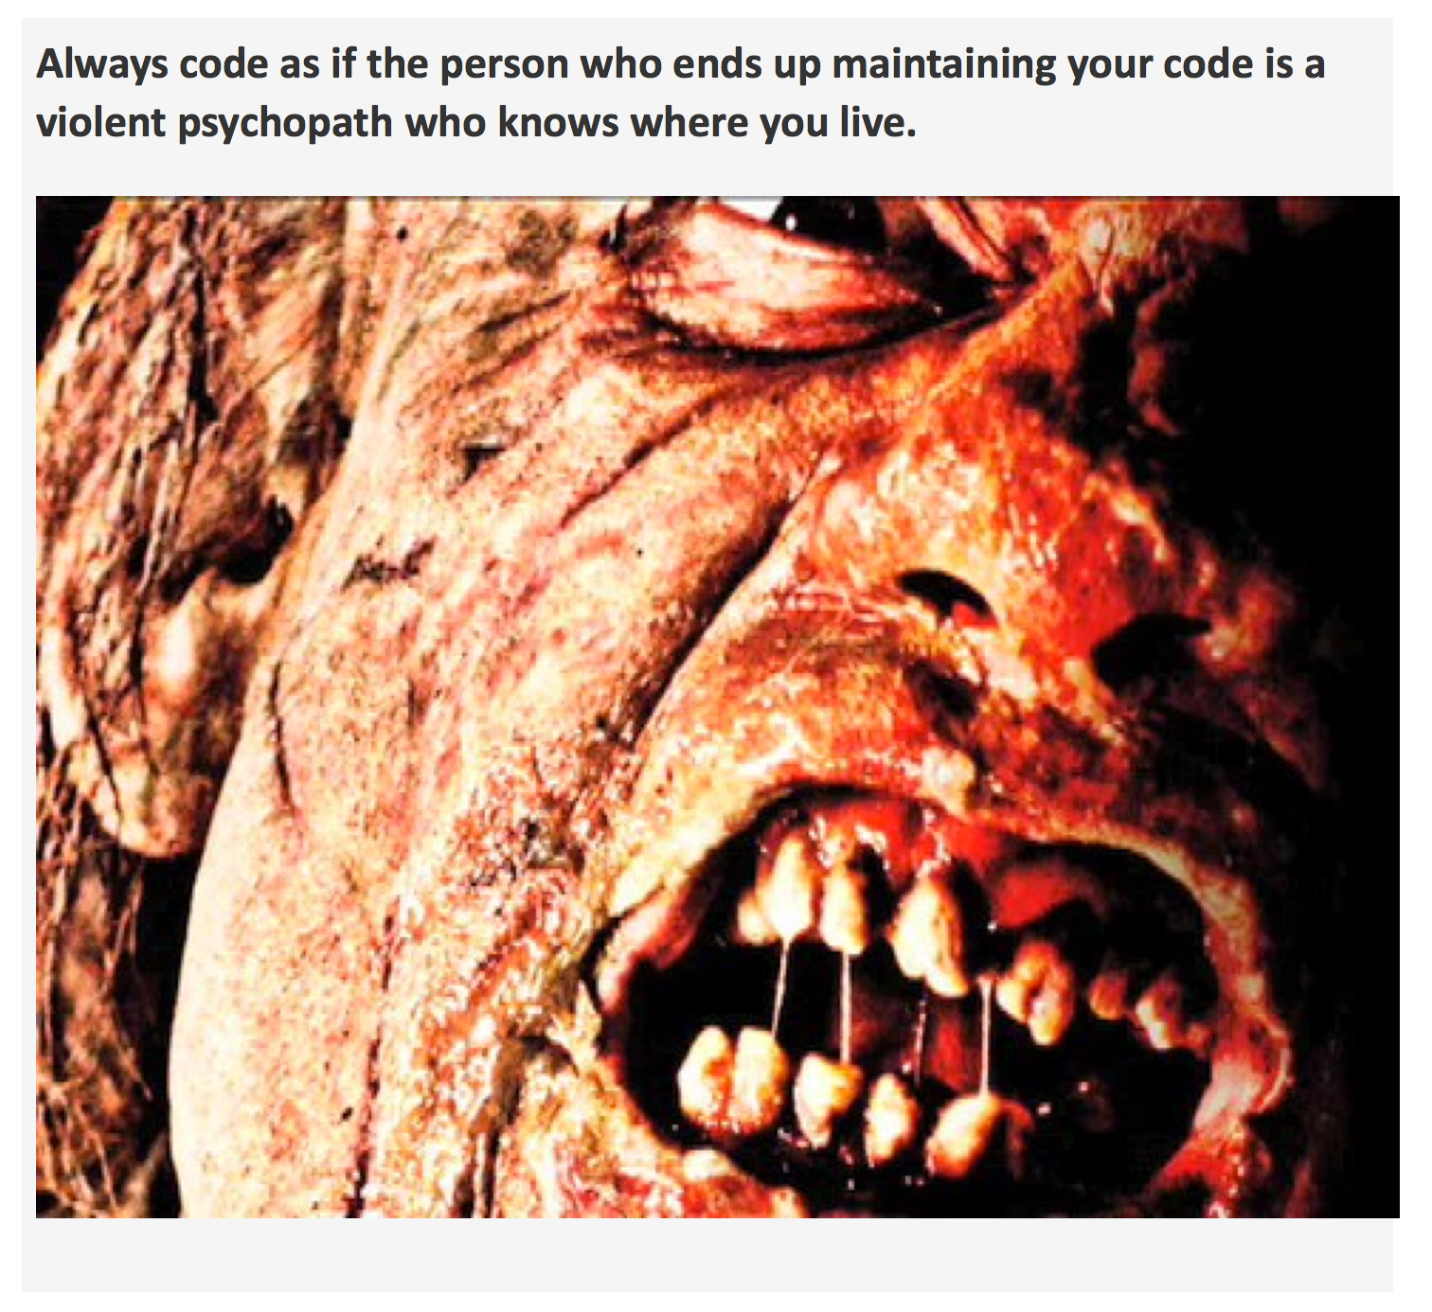
- John Woods

Slide 22

Put Synthesis in Code Layer
var rewrite = synthesizeSed({ //expectedOutput: [/(\w).*\s+(\w+)/, “$2, $1./”],
examples: [
[“Emina Torlak”, [“E”, “Torlak”], “Torlak, E.”],
[“Leo A. Meyerovich”, [“L”, “Meyerovich”], “Meyerovich, L.”]]
replaceHint: “?, ?.”});
do at compile-time!

Slide 23
Data Wrangling with Synthesis
1. Extract
2. Transform
data1.log
extract1.sed
3. Load
data2.csv
extract2.sed
join.sql
view.html
data3.doc
extract3.sed
✔
REGEX synthesizer
SQL synthesizer
VIZ synthesizer

Slide 24
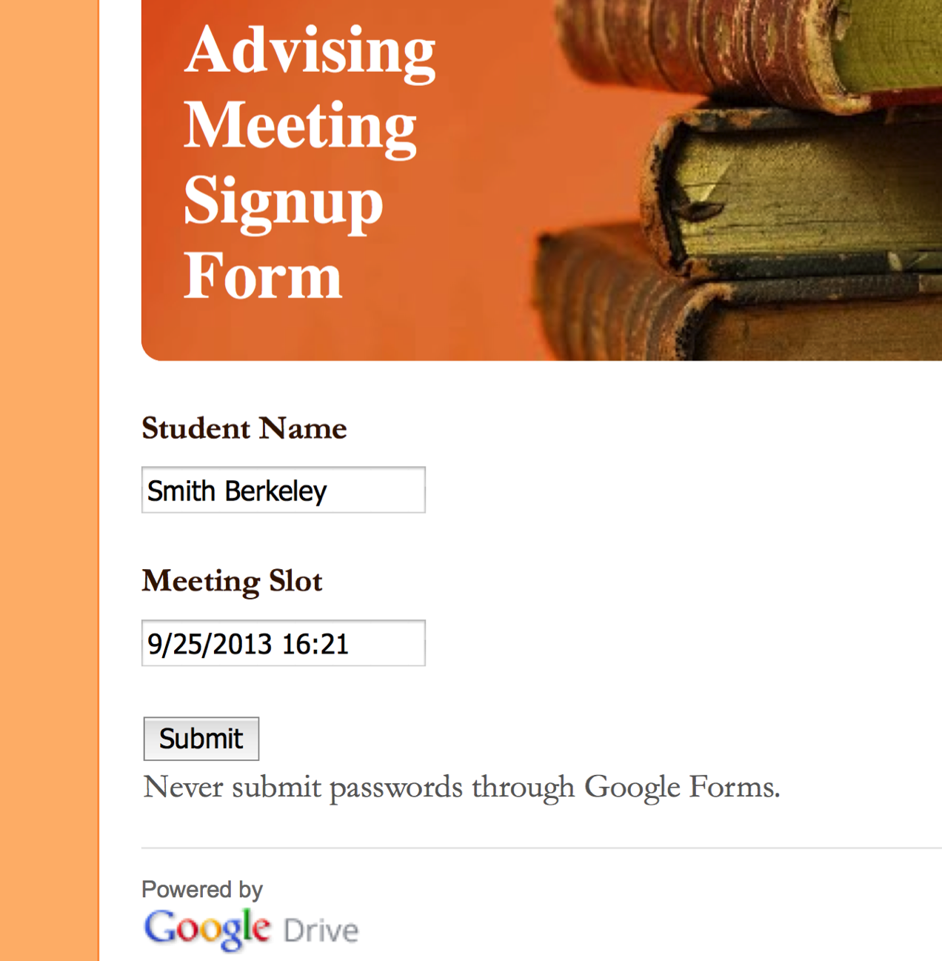
Who didn’t
sign up?

Slide 25
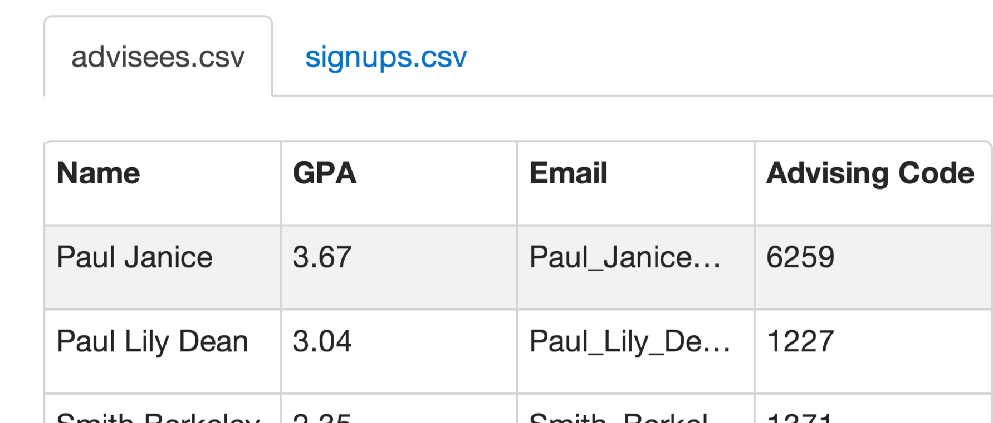
Data Sources to Combine
just signups.csv
all advisees.csv

Slide 26
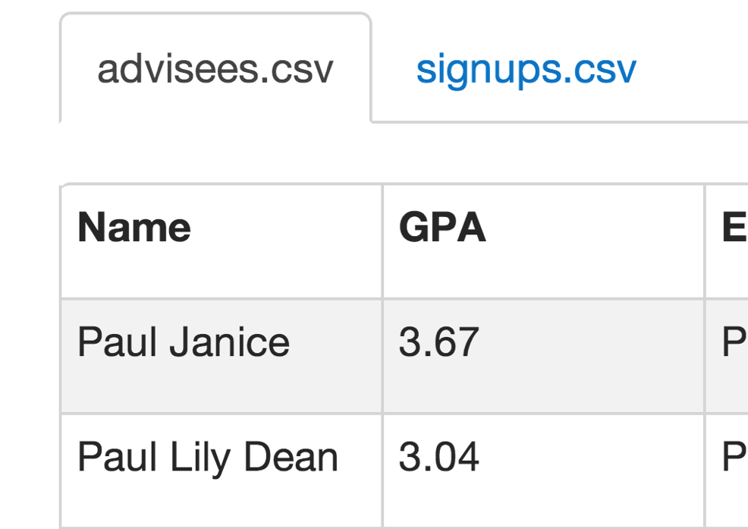
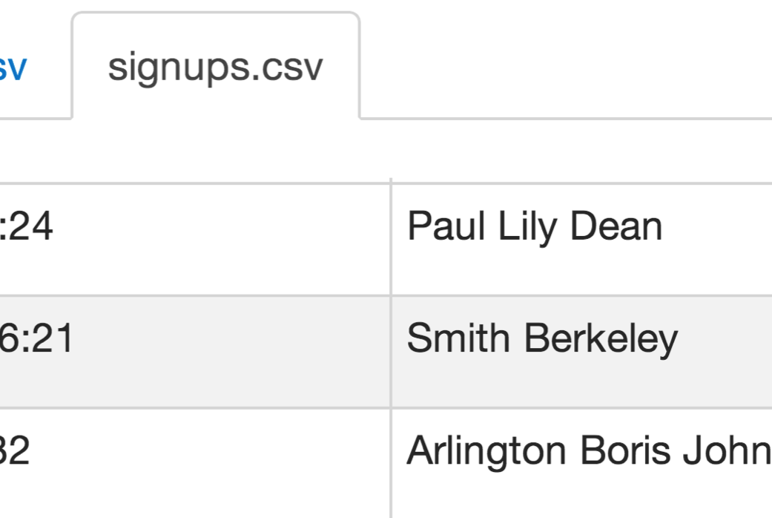
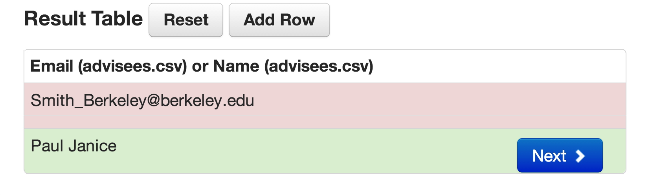
Flag Janice as No Show
Ignore Smith as Signed up
Positive
Example
Counter Example

Slide 27
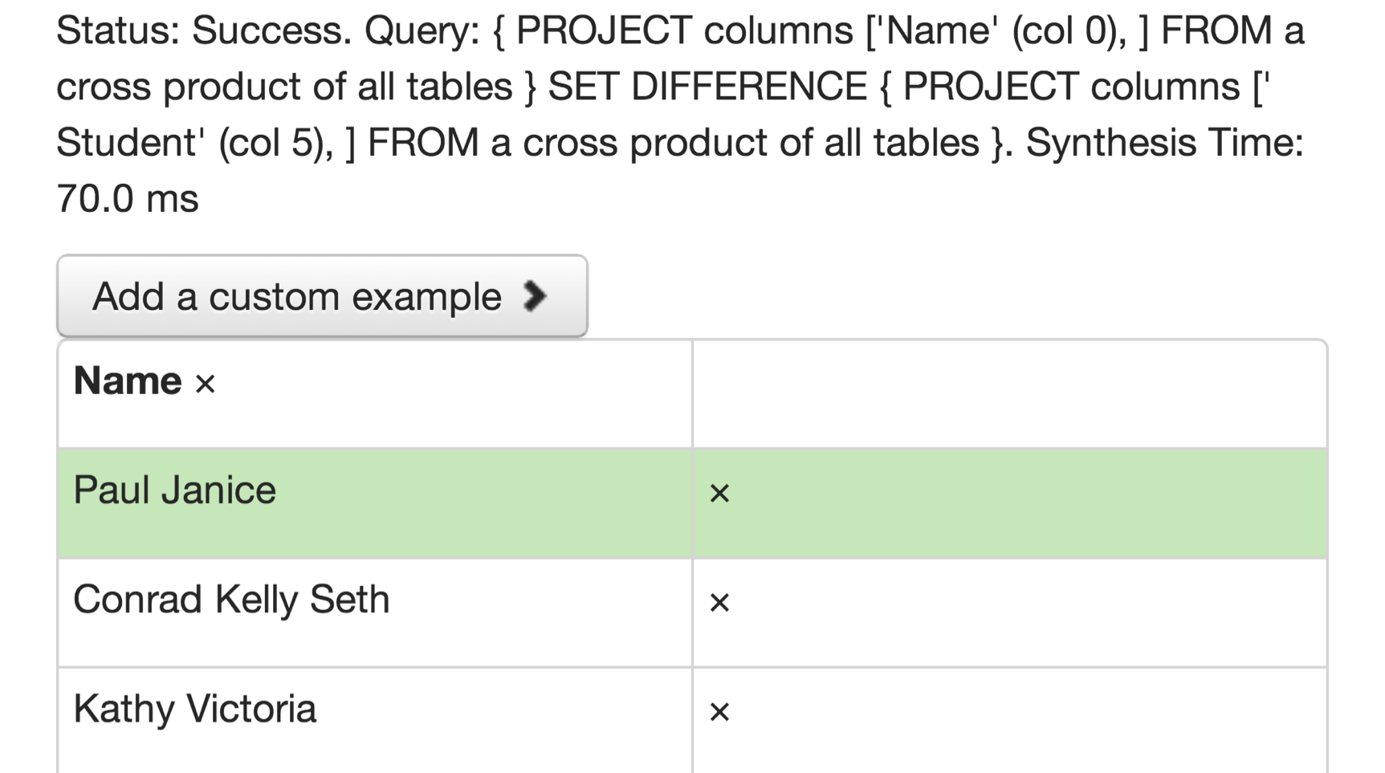
SQL Synthesis in 0.07s!
SMT backend synthesizes generic SQL

Slide 28
Synthesis is Coming
median programmer salary

Slide 29
Synthesis is Coming
median programmer salary
linux kernel, K SLOC

Slide 30
Synthesis is Coming
median programmer salary
linux kernel, K SLOC
top supercomputer
teraFLOP/s
Brute force search

Slide 31
Synthesis is Coming
median programmer salary
linux kernel, K SLOC
top supercomputer
teraFLOP/s
SAT solver: K variables
Heuristics inlining, …

Slide 32
Thinking DSLs for Massive Visualization

Slide 33
Origins
Superconductor
http://sc-lang.com
Writing a multicore browser in C++ is a hard way to do a Ph.D.

Slide 34
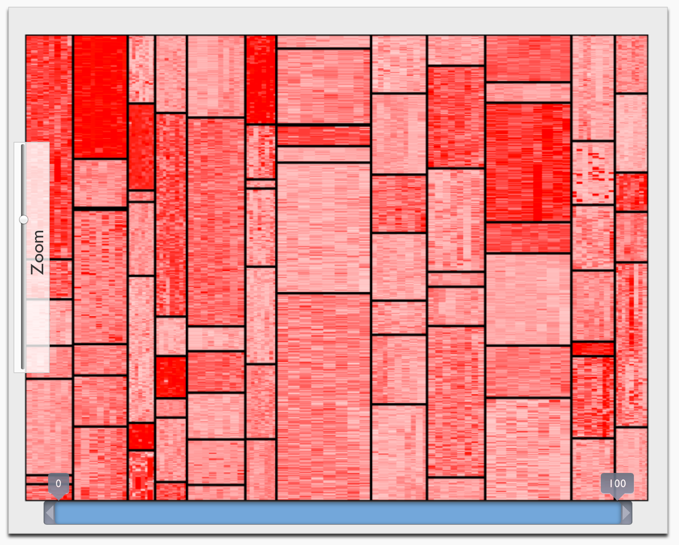

Slide 35
Why I Care
Show 2-3 magnitudes more data
Explore data with new interactions
Web: programmable, portable, shareable, …

Slide 36
Superconductor Architecture: Parallel Browser-in-a-Browser
data viz
multicore
webpage
data
styling
widgets
Parser.js
Parser
HTML data
CSS styling
JS script
Parallel DSLs
Synthesis in layout DSL
Selectors.CL
JavaScript VM
Selectors
GPU
Layout.CL
Layout
Compiler
Data stays on GPU!
Renderer.GL
Renderer
Pixels
superconductor.js

Slide 37
Layout DSL: Fast Tree Language
CSS + Constraints = Attribute Grammar
Local
10px
5px
Root
y
w
x
h
HBox {
w := left.w + right.w
…
input: x, y
HBox
y
x
w
h
var: w, h, r
left
right
HBox
Leaf
Leaf
w
x
y
y
h
w
x
h
2. Single-assignment
Leaf
Leaf
w
x
y
h
w
x
y
h
Notes:
First line: To demonstrate how to specify a layout in our system let’s look at an example, specifically an Hbox
Hbox is one of many layout components that positions its contents horizontally
In specification form, this means that the width attribute of Hbox is the sum of the children’s widths
Rest of Hbox specified in a similar manner, for instance…
- Given a set of such specifications for all layout components, we need to find a ordering of assignments that solves an input tree

Slide 38
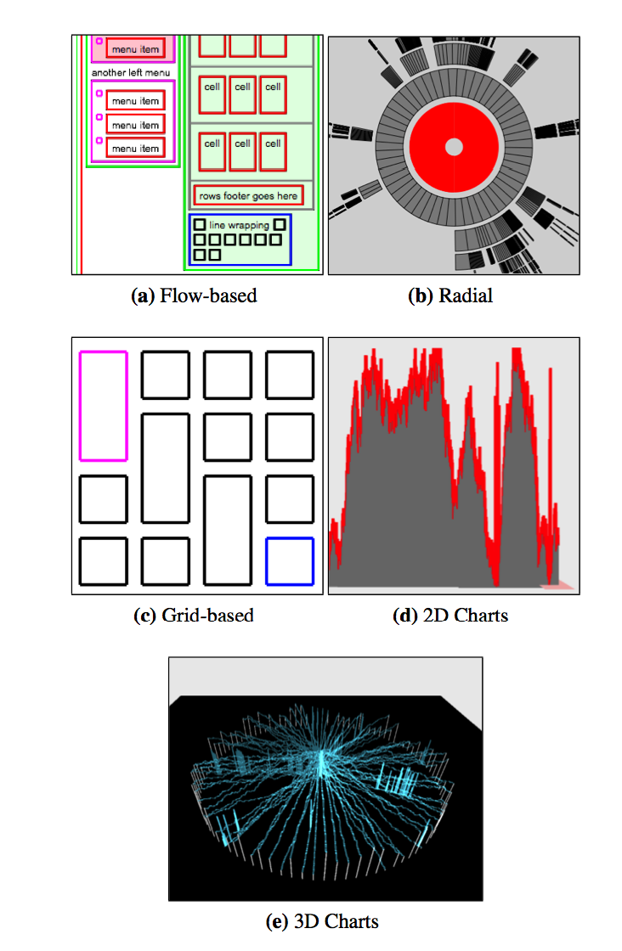
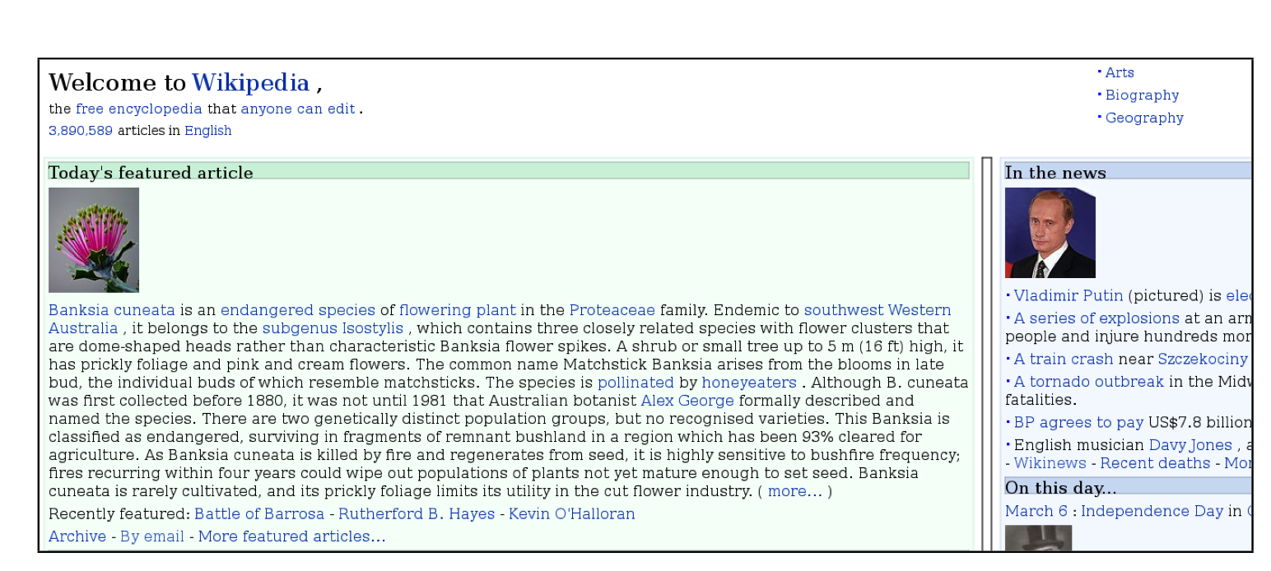
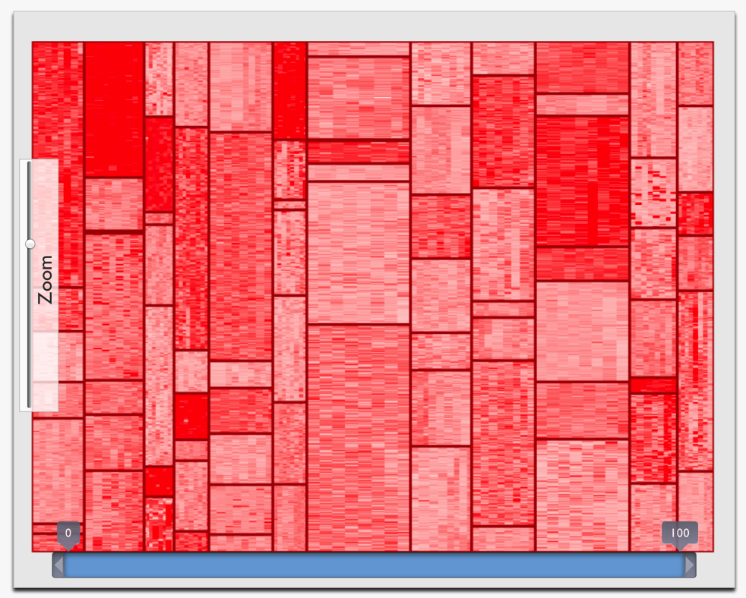
Layout DSL is Flexible!
multicore
GPU
multicore
multicore
GPU
GPU
GPU

Slide 39
???
layout.ftl
synthesizer
engine.js

Slide 40







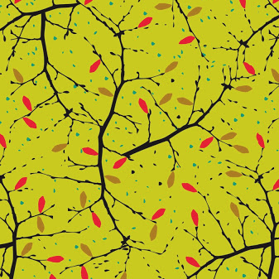




Parallel Patterns

Slide 41
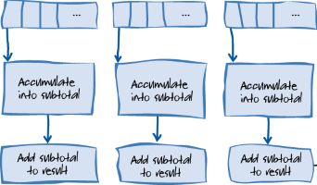
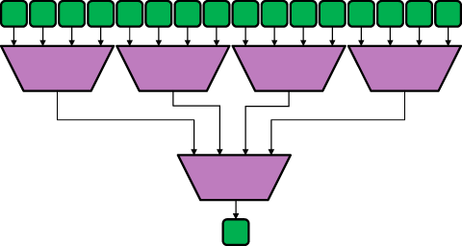
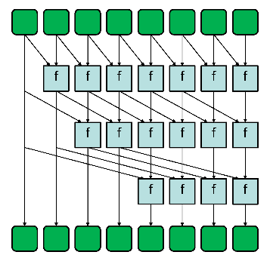
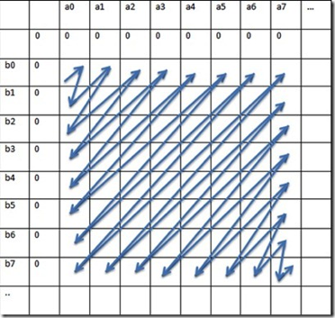
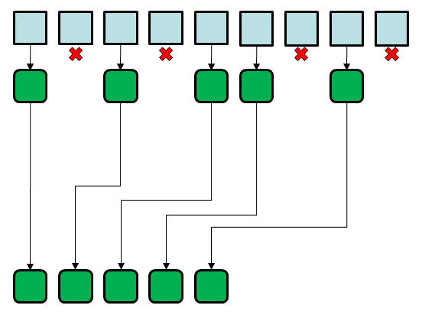
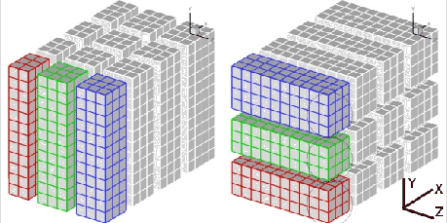
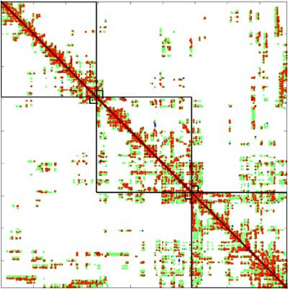
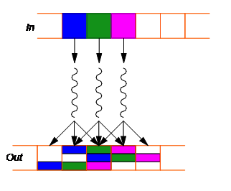
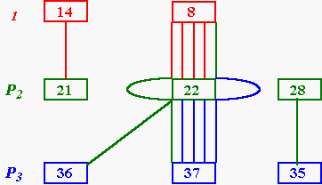
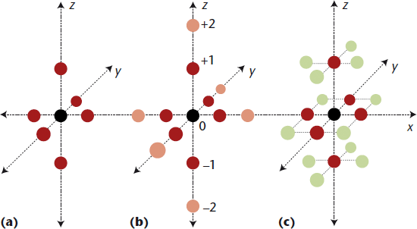
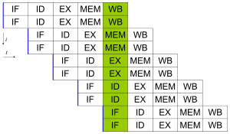
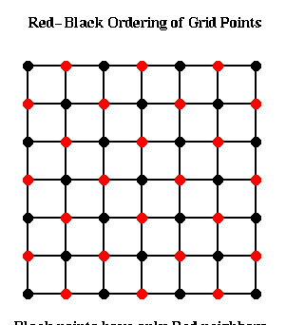
Parallel Algorithms are Patterns
Map
Reduce
Prefix Sum
Wavefront
Pack
Transpose
Sparse
Scatter
Etc.
Duplication
N-point stencils
Pipeline
Overlap C&C

Slide 42
Schedule Layout as Parallel Tree Traversals
constraints
on node attributes
logical joins
h0=max(h1,h2)
w0=f (w1,w2)
x,y
…
w,h
w,h
logical fork
w,h
Leaf
w,h
document
tree
w,h
w,h
Parallelism in each traversal!
Schedule correct for all data sets

Slide 43
Schedule in Action
schedule {
[ (⬆, [(VBox, [w, h]), (HBox, [w, h])]),
“;”,
(⬇, [(VBox, [x, y]), (HBox, [x, y])])] }
HBox { w := left.w + right .w
…

Slide 44
One Layout Traversal on GPU “Level-synchronous Breadth-First”
level 1
Benefits
Parallelism!
Data never leaves GPU
parallel for loop
level n
JSON Tree
Notes:
Gloss over details of what is going on. Take away should be: this stuff is complicated, but don’t worry, compiler does it all for you.
[what is meant by ‘subtree’ here? And ‘including edges’? Get this slide clarified.]

Slide 45
Layout on GPU: Must “Flatten” Tree
y
x
Array per attribute
h
w
level 1
Nodes in arrays
level n
JSON Tree
Superconductor does this for you.
Notes:
Gloss over details of what is going on. Take away should be: this stuff is complicated, but don’t worry, compiler does it all for you.
[what is meant by ‘subtree’ here? And ‘including edges’? Get this slide clarified.]

Slide 46
Need “Structured Programming” for Automatically Parallel Languages
behavioral spec
schedule sketch
functional spec layout.ftl
Synthesizer
schedule ⬆{w,h}; ⬇{x, …
treemap v1, v2, …

Slide 47

Input: Partial Schedule (“Sketch”)
⬆ _ ;⬇_ ;⬆_ ;⬇_;⬆_ ;⬇_;nest({Text,Font,Inline}, _);⬆_;⬇_
w, h
sequential_inorder{y,r}
OK: rescheduling attribs
bug: less parallelism!
Hole for code to generate via synthesis: ⬆, {x,y}, “||”, …
Synthesizer rejects programs that cannot obey sketch
Structures parallel programming:
Helped sharing code, testing ideas, and debugging

Slide 48
Synthesis for Data Science.. What Else?
Regex ✔ SQL ✔ AG Parallelization
Spatial Computing Crash Recovery
Java Synthetic Biology Bit Arithmetic Concurrent Data Structures UI Layout
Geometry Type Systems Security Policies
C Web Scraping Circuit Design

Slide 49

Synthesis Languages:
Don’t do the Compiler’s Work!

